Slide 1
MS&E328/CS328 Foundations of Causal Machine Learning
Vasilis Syrgkanis
Stanford University
Assistant Professor
Management Science and Engineering
(by courtesy) Computer Science and Electrical Engineering
Institute for Computational and Mathematical Engineering

Slide 2
Logistics
Instructor: Vasilis Syrgkanis, Asst. Professor of Management Science and Engineering, (courtesy) Computer Science and Electrical Engineering
Office Hours: Monday 5-6pm, Huang 252
Lectures: Friday 1.30-2.50 (10min break) 3-4.20, Turing Auditorium
Grading: Class Presentations (30%), Project Report (70%)
Webpage: https://stanford-msande328.github.io/winter26/
Prior offering: https://stanford-msande328.github.io/fall24/
Project: Literature review on a particular topic related to class, covering at least 3 papers in depth. Replication of experiments in one paper or improvement on theoretical results (even if incremental). Proposal Due: Jan 30th. Lit Review Due: Feb 28th. Final Report Due: March 20th
Presentations: 20min presentation of your research project

Slide 3
Class Goals
Uncover the statistical and computational foundations of modern methods in causal effect identification and machine learning based estimation
Be able to prove results on the identification of causal effects and understand novel arguments on causal effect identification
Be able to prove results on the statistical properties of machine learning based estimation of causal parameters and causal functions, such as asymptotic normality and rates of convergence
Be able to present understand and present papers on these topics

Slide 4
Causal Identification
Potential Outcomes Structural Equations Directed Acyclic Graphs (DAGs)
Graphical Criteria Single World Intervention Graphs
Unobserved Confounding: Instruments, Diff-in-Diff, Regression Discontinuity
Double/Debiased Machine Learning (DML)
Automatic DML for Static and Dynamic Treatments (Reinforcement Learning)
Automatic DML for Proximal Inference and Instrumental Variables
Statistical learning theory for heterogeneous treatment effects
Non-parametric inference for heterogeneous treatment effects (Causal Forests)
Statistical learning theory for conditional moment problems (instrumental variables)
Estimation and Inference on Causal Parameters
Estimation and Inference on Causal Functions

Slide 5
Related Courses
Applied Causal Inference with Machine Learning and AI
https://stanford-msande228.github.io/winter26/
ECON 272: Intermediate Econometrics III: Methods for Applied Econometrics (Imbens)
MGTECON 634: Machine Learning and Causal Inference (Athey, Wager)
MGTECON 614: Emerging Topics in Econometrics (Lihua Lei)
MS&E 226: Fundamentals of Data Science: Prediction, Inference, Causality (Johari)
STATS 209: Introduction to Causal Inference (Rothenhaeusler)
STATS 361: Causal Inference (Rothenhaeusler, Wager)
https://datascience.stanford.edu/causal/courses

Slide 6
Introduction Causal Machine Learning in Practice Case Studies and Challenges
Vasilis Syrgkanis
Stanford University

Slide 7
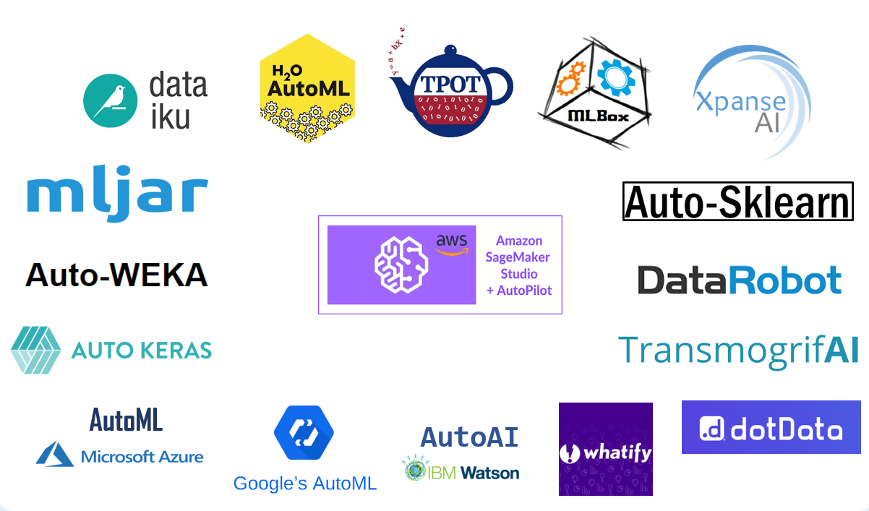
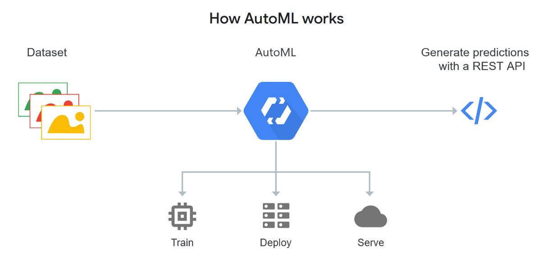
The Ease of Use of Machine Learning
Almost everyone with access to a dataset and an outcome of interest can construct an ML predictive model

Slide 8
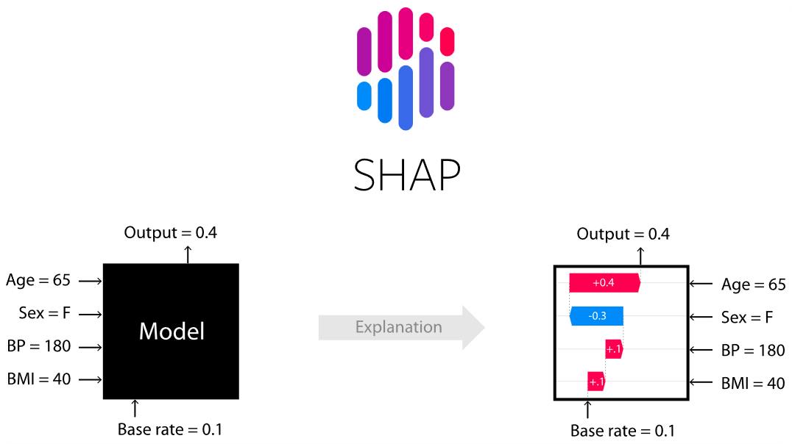
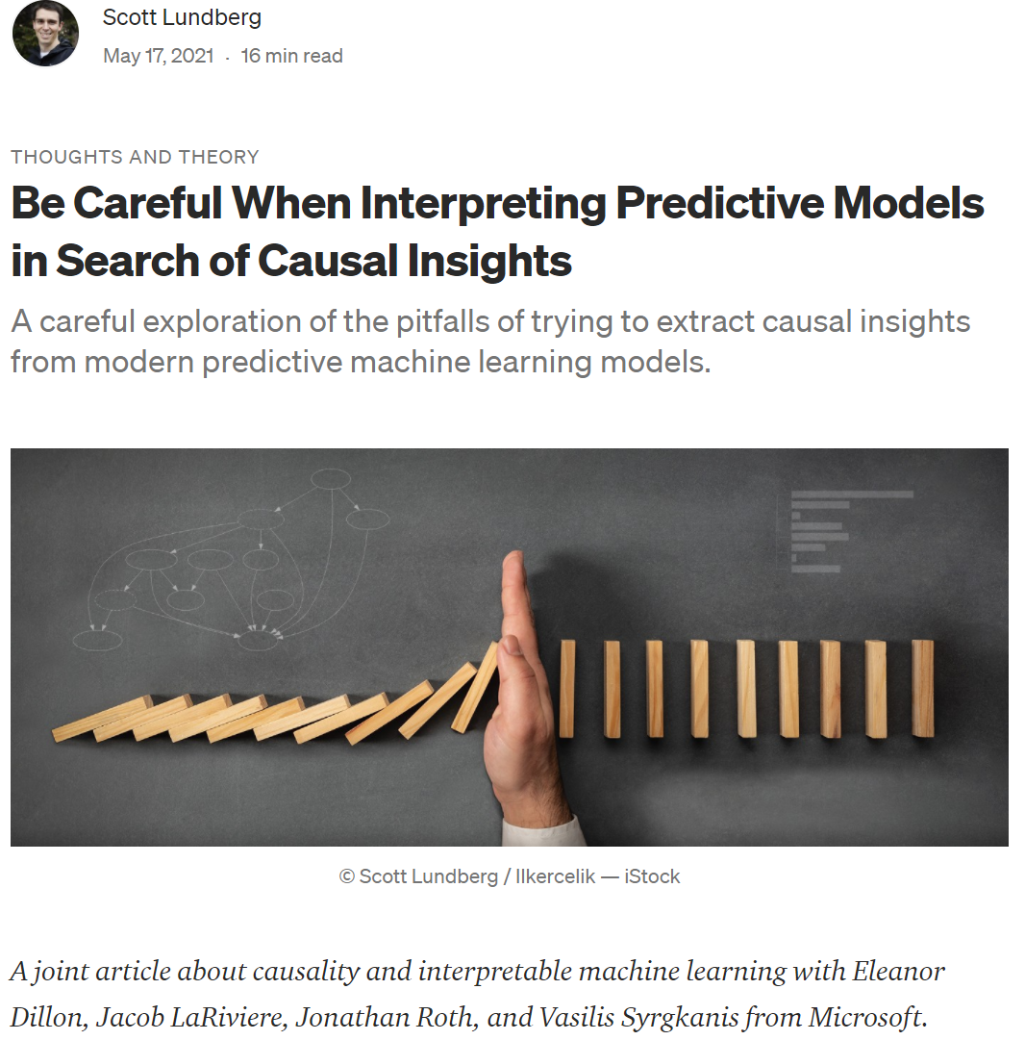
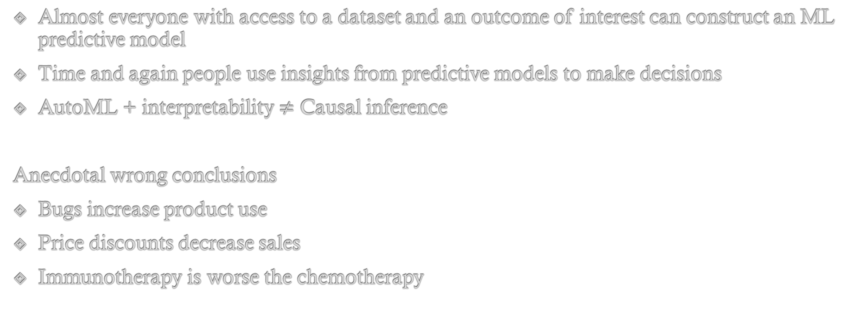
The Ease of (mis)Use of Machine Learning
Almost everyone with access to a dataset and an outcome of interest can construct an ML predictive model
Time and again people use insights from predictive models to make decisions
AutoML + interpretability $≠$ Causal inference
Anecdotal wrong conclusions
Bugs increase product use
Price discounts decrease sales
Immunotherapy is worse the chemotherapy

Slide 9

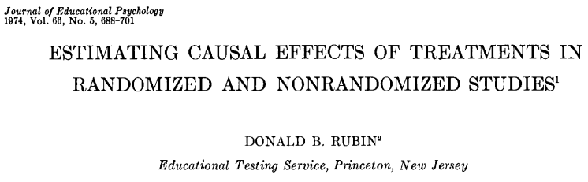

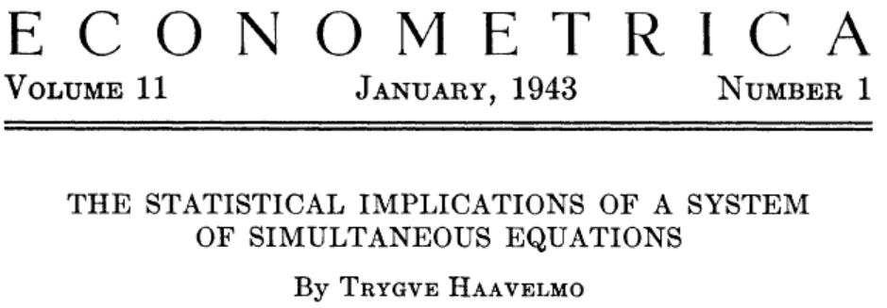

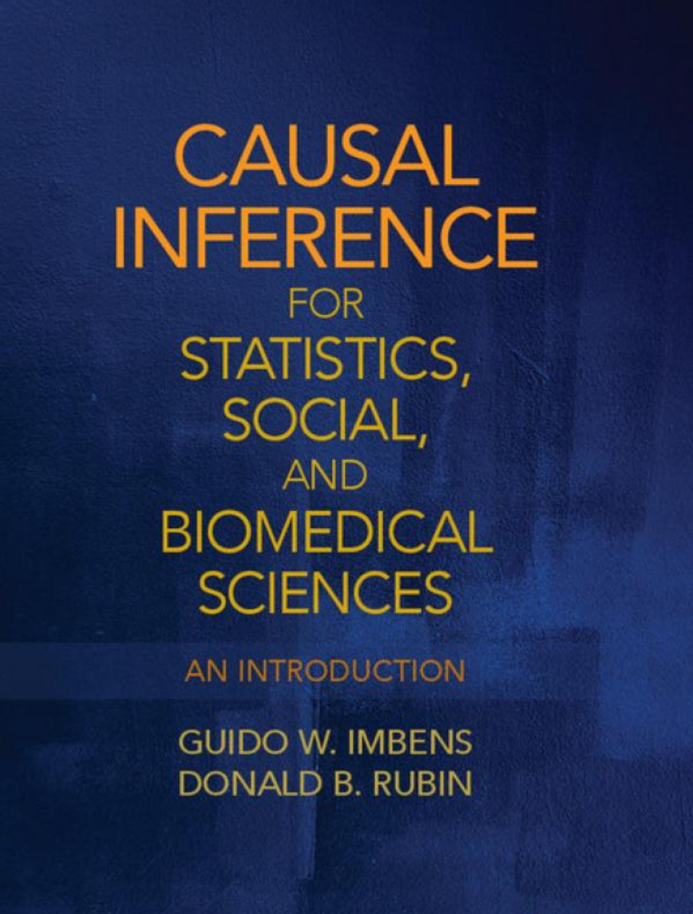
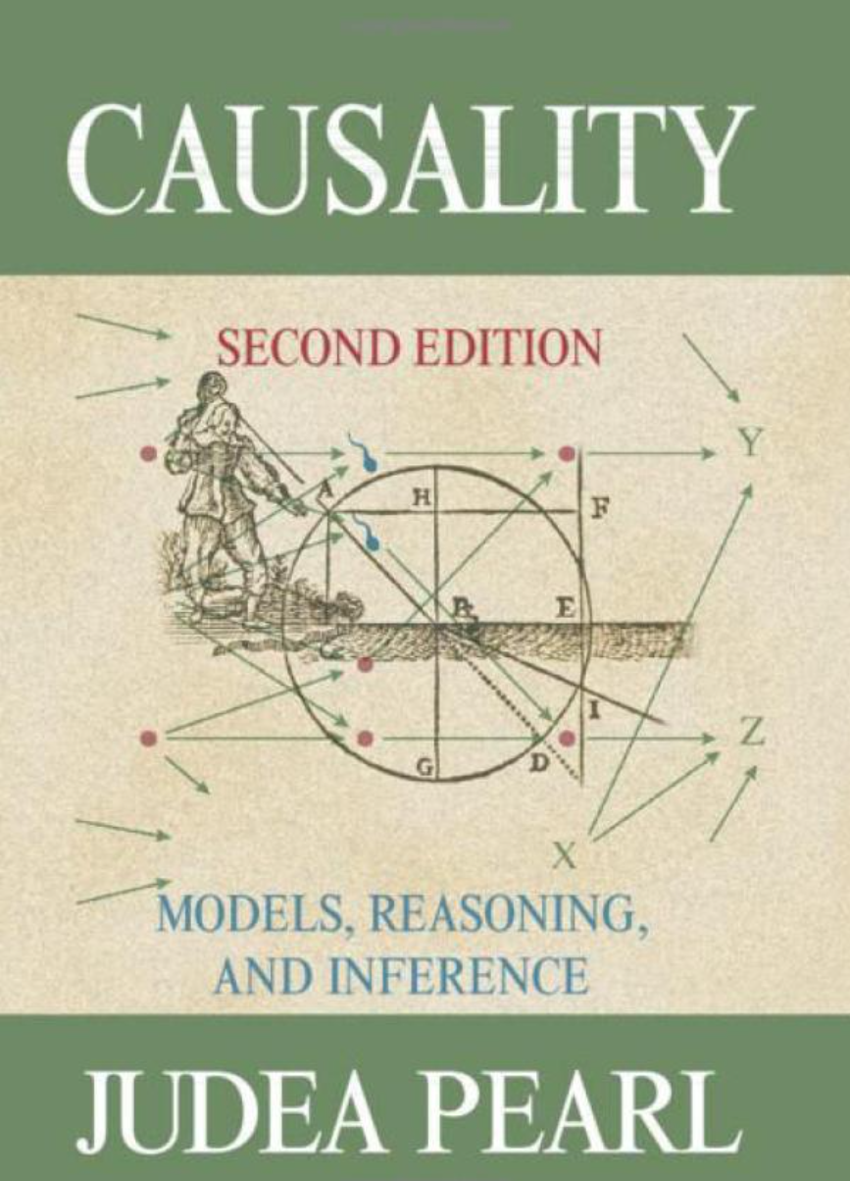
Causal Inference
Addresses interventional (what-if) statistical questions and the identification of causal relationships from data

Slide 10
Causal inference in new data modalities
Richer datasets (10s or 100s of variables)
Un-structured data (text, images, genomics)
Personalization (heterogeneous effect models)
Automatic model selection/model robustness/researcher bias robustness
Exactly the topics where predictive machine learning techniques really shine!

Slide 11
ML helps bypass the curse of dimensionality
ML methods automatically adapt to unknown complexity of the truth
Adapt to number of relevant features (Lasso, Random Forests)
Adapt to low dimensionality of covariate distribution (Nearest Neighbor regression)
Adapt to the “complexity/smoothness” of true model (Kernel Ridge)
Build data-driven low dimensional feature representations (Neural Networks)

Slide 12
Causal Machine Learning
Re-directing the ability of machine learning estimators to bypass the curse of dimensionality, from the current focus of solving prediction problems to solving statistical problems that arise in causal inference.

Slide 13
Many industrial and scientific use cases
Return-on-investment, pricing, customer segmentation and personalization
Experimentation in tech industry
Personalized medicine
Heterogeneity of effect in social science studies

Slide 14
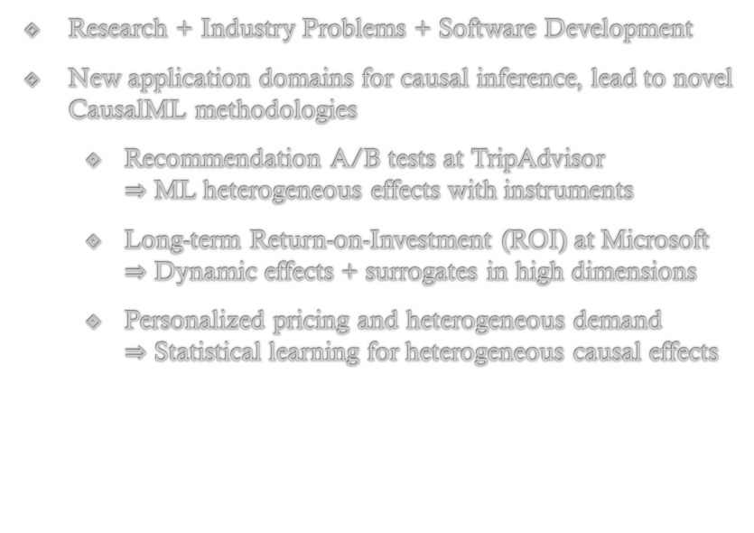
The ALICE project
(Automated Learning and Intelligence for Causation and Economics)
Research + Industry Problems + Software Development
New application domains for causal inference, lead to novel CausalML methodologies
Recommendation A/B tests at TripAdvisor $⇒$ ML heterogeneous effects with instruments
Long-term Return-on-Investment (ROI) at Microsoft $⇒$ Dynamic effects + surrogates in high dimensions
Personalized pricing and heterogeneous demand $⇒$ Statistical learning for heterogeneous causal effects
Major research challenges
High-dimensionality of data and valid inference [ICML’18a, COLT’20, NeurIPS’21, CLeaR’22, Arxiv’21a,b,c]
Unobserved confounding [NeurIPS’19, NeurIPS’20]
Dynamic aspects of decision making [NeurIPS’15, ICML’16, NeurIPS’16, FOCS’17, EC’15, ICML’18b,c, ICML’21, NeurIPS’21a,b]
Personalized effects and policies [ICML’19, NeurIPS’19, COLT’19, CLeaR’22]
New problems in statistical learning theory, high-dimensional statistics, semi-parametric and non-parametric inference theory, optimization theory, online learning theory

Slide 15




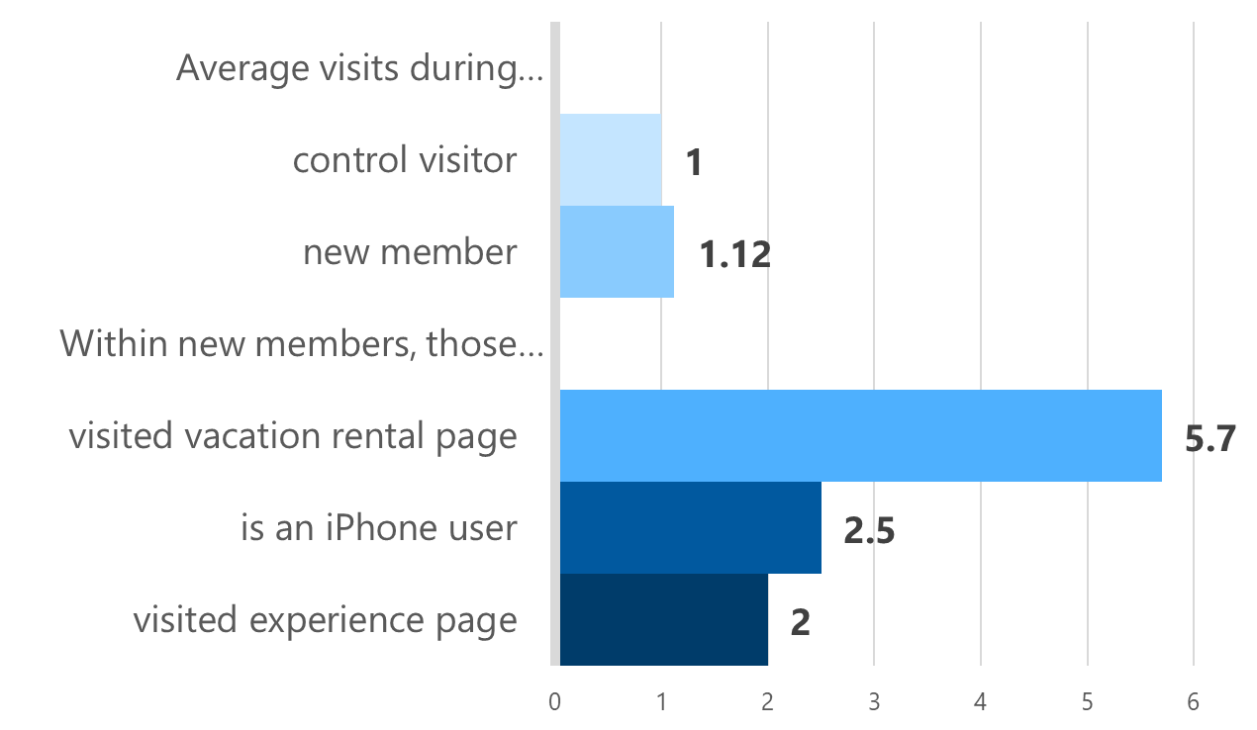









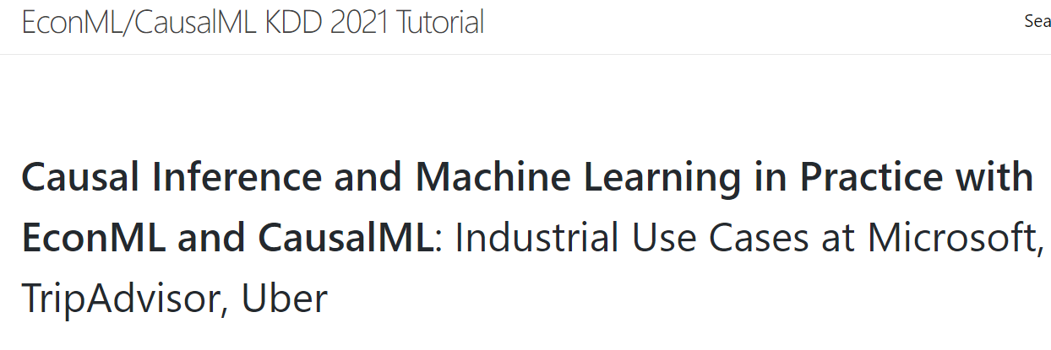
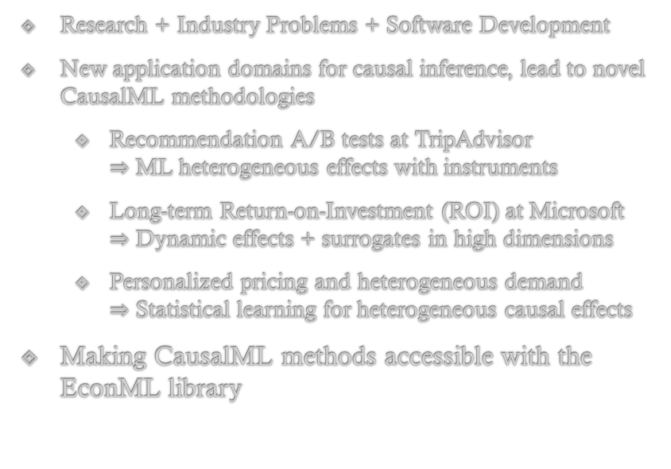
The ALICE project
”Developing a deep understanding of our travelers so we can create truly relevant experiences is at the core of what we do at TripAdvisor. Our partnership with Microsoft Research has allowed us to unlock critical insights that inform how to improve those experiences in a 1:1 manner.”
—Matthew Dacey, Vice President
Membership and Growth at TripAdvisor
Heterogeneous Effect of Membership
Research + Industry Problems + Software Development
New application domains for causal inference, lead to novel CausalML methodologies
Recommendation A/B tests at TripAdvisor $⇒$ ML heterogeneous effects with instruments
Long-term Return-on-Investment (ROI) at Microsoft $⇒$ Dynamic effects + surrogates in high dimensions
Personalized pricing and heterogeneous demand $⇒$ Statistical learning for heterogeneous causal effects
Making CausalML methods accessible with the EconML library

Slide 16

Deep Dive 1: Recommendation A/B Tests
Through the lens of a Case-Study at TripAdvisor

Slide 17
TripAdvisor Membership Problem
What is the causal effect of becoming a member on TripAdvisor on downstream activity on the webpage?
How does that effect vary with observable characteristics of the user?
Useful for understanding the quality of membership offering/improvements/targeting
Notes:
With TripAdvisor, we wanted to answer the following problem:
what is the causal effect of becoming a member on TripAdvisor on downstream activity on the webpage and
how does that effect vary with observable characteristics of the user
An answer to this problem can be useful to understand the quality of the membership offering, make improvements and target segments of the user base to incentivize membership.
1.10-1.30

Slide 18
TripAdvisor Membership Problem
What is the causal effect of becoming a member on TripAdvisor on downstream activity on the webpage?
How does that effect vary with observable characteristics of the user?
Useful for understanding the quality of membership offering/improvements/targeting
Standard approach: Let’s run an A/B test!
Not applicable: We cannot enforce the treatment!
We cannot take a random half of the users and make them members
Membership is an action that requires user engagement!
Notes:
The standard approach that the tech industry takes to address such questions is to run an A/B test.
Unfortunately, an A/B test is not feasible here, since we cannot enforce the treatment.
We cannot take a random half of the users and make them members.
Membership is an action that requires user engagement.
1.30 - 2

Slide 19
Recommendation A/B Tests
In optimizing a service we want to understand the causal effects of actions that involve user engagement (e.g. becoming a member)
Notes:
And this is a problem that many companies are facing:
when optimizing a service, many times you want to understand the causal effects of actions that involve user engagement.
2 – 2.10

Slide 20
Recommendation A/B Tests
In optimizing a service we want to understand the causal effects of actions that involve user engagement (e.g. becoming a member)
We can run a recommendation A/B test:
“recommend/create extra incentives” to half the users to take the action/treatment
Example at TripAdvisor: enable an easier sign-up flow process for a random half of users
Notes:
Even though one cannot run a traditional A/B test, we can still run a “recommendation A/B test”:
we can recommend or create extra incentives for a random half of users to take the action or treatment.
For example in the TripAdvisor problem we can enable an easier sign-up flow process for a random half of the users.
2.10-2.30

Slide 21
Recommendation A/B Tests
In optimizing a service we want to understand the causal effects of actions that involve user engagement (e.g. becoming a member)
We can run a recommendation A/B test:
“recommend/create extra incentives” to half the users to take the action/treatment
Example at TripAdvisor: enable an easier sign-up flow process for a random half of users
Non-Compliance: ``user’s choice to comply or not`` can lead to biased estimates
Notes:
However, recommendation A/B tests pose an extra difficulty as compared to standard A/B tests.
The fact that users choose themselves to comply or not with the recommendation, leads to potential unobserved confounding
Hence, we run the risk of getting biased estimates if we treat the resulting data as if they came from a classical A/B test.
2.30-2.50

Slide 22
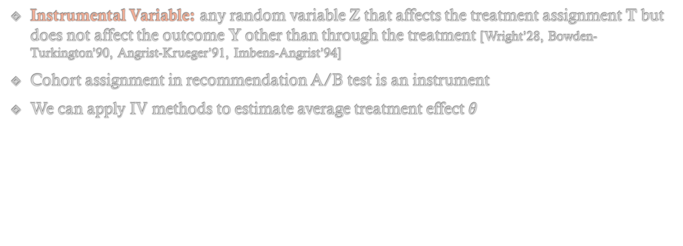
Instrumental Variables (IV)
Instrumental Variable: any random variable Z that affects the treatment assignment T but does not affect the outcome Y other than through the treatment [Wright’28, Bowden-Turkington’90, Angrist-Krueger’91, Imbens-Angrist’94]
Cohort assignment in recommendation A/B test is an instrument
We can apply IV methods to estimate average treatment effect $θ$
Notes:
Here is where econometric techniques can prove very useful.
We can view the cohort assignment in a recommendation A/B test as an instrument, since it is a random variable that affects the treatment assignment but does not affect the outcome of interest other than through the treatment assignment.
Thus we can apply IV methods in order to estimate the average effect of becoming a member.
2.50-3.20

Slide 23
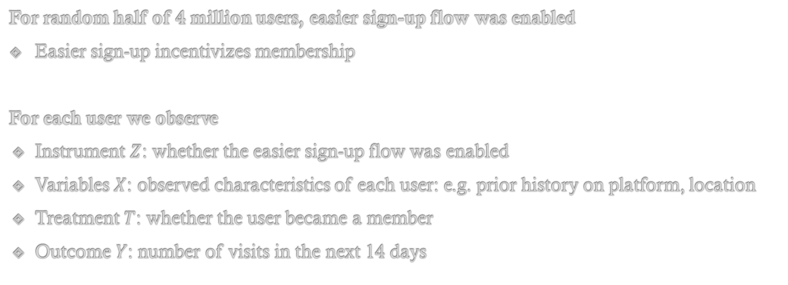
TripAdvisor Experiment
For random half of 4 million users, easier sign-up flow was enabled
Easier sign-up incentivizes membership
For each user we observe
Instrument $Z$: whether the easier sign-up flow was enabled
Variables $X$: observed characteristics of each user: e.g. prior history on platform, location
Treatment $T$: whether the user became a member
Outcome $Y$: number of visits in the next 14 days
Notes:
This is what TripAdvisor did.
They run a recommendation A/B test, where for a random half of 4 million users, they enabled an easier sign-up process.
Easier sign-up incentivizes membership.
After the experiment we observe for each user:
Whether the easier sign-up process was enabled
Several characteristics of the user, such as prior history on the platform or geolocation
Whether the user ended up becoming a member, in other words, whether they took the treatment
And the outcome of interest, which in this case was chosen as the number of visits in the next 14 days.
3.20 – 4

Slide 24
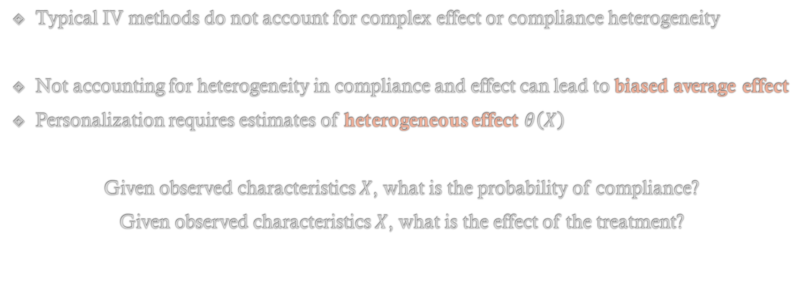
Effect and Compliance Heterogeneity
Typical IV methods do not account for complex effect or compliance heterogeneity
Not accounting for heterogeneity in compliance and effect can lead to biased average effect
Personalization requires estimates of heterogeneous effect $θ\left(X\right)$
Given observed characteristics $X$, what is the probability of compliance?
Given observed characteristics $X$, what is the effect of the treatment?
Notes:
We then wanted to analyze these data with instrumental variable methods
The starting point of the methodological part of the work, was that typical IV methods do not account for complex effect or compliance heterogeneity.
Not accounting correctly how compliance and treatment effect vary with observable characteristics can lead to biased effect estimates.
For instance, if people who look like X, both comply more and the treatment has a larger effect on them, then we run the risk of estimating effects with an upwards bias.
Moreover, in this setting, we were not just interested in estimating an average effect but estimating how the effect varies with observable characteristics was of primary interest, as the goal was to potentially deploy a personalized policy.
Thus we need to be able to estimate from our data, flexible statistical models that answer the following two questions:
Given observed characteristics X, what is the probability of compliance
Given observed characteristics X, what is the effect of the treatment
These two questions I believe are representative of the two major reasons why there is a need to estimate flexible statistical models in policy problems
4 - 5

Slide 25
Can we decompose IV estimation into (ML) prediction problems?
Notes:
Going back to our original problem: can we decompose the IV estimation problem into a sequence of prediction problems that we can address with Machine learning and leverage this statistical power?
8-8.10

Slide 26

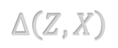

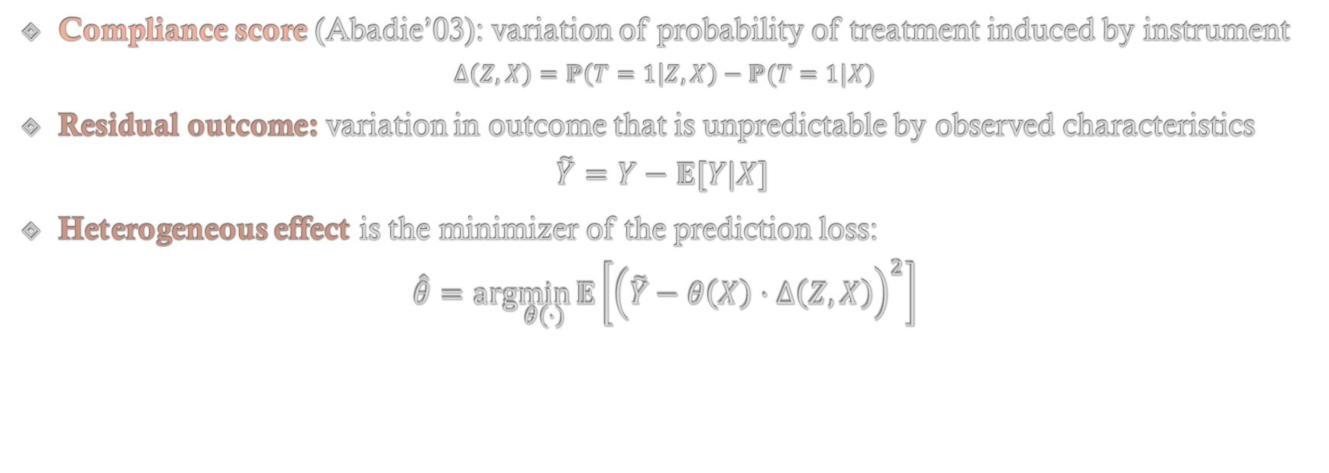
De-composing into Prediction Problems
Compliance score (Abadie’03): variation of probability of treatment induced by instrument
$$Δ\left(Z,X\right)=ℙ\left(T=1 | Z,X\right)−ℙ(T=1|X)$$
Residual outcome: variation in outcome that is unpredictable by observed characteristics
$$\tilde{Y}=Y−𝔼[Y|X]$$
Heterogeneous effect is the minimizer of the prediction loss:
$$\hat{θ}=arg\min_{θ\left(⋅\right)}{𝔼\left[{\left(\tilde{Y}−θ\left(X\right)⋅Δ\left(Z,X\right)\right)}^{2}\right]}$$
ML
unexplained variation in outcome
exogenous variation of treatment induced by instrument
linear model where the coefficient can vary with observable characteristics
Predict
from
using
$$\tilde{Y}$$
$$Δ\left(Z,X\right)$$
$$θ\left(X\right)⋅Δ\left(Z,X\right)$$
Notes:
Here is one way to achieve this:
First, we need to estimate the following two quantities for each user type X
The first is known as the compliance score and corresponds to the “unconfounded” or “exogenous” variation in the probability of treatment that is induced by the instrument
This corresponds to the difference between two prediction problems: the first predicts the probability of treatment conditional on the instrument and the user characteristics and the second predicts the probability of treatment simply based on user characteristics irrespective of instrument
The second is the residual outcome: which is the variation in the outcome that is not explained by the user type
This corresponds to the difference between the outcome and the output of another prediction problem that predicts the outcome based on the user type
Thus we can use ML to solve all these prediction problems
Finally, for each user type X, the effect of the treatment is the correlation between the unexplained variation in the outcome and the exogenous variation in the treatment
Thus estimating the heterogeneous effect can be framed as, yet another prediction problem, where
we want to predict the unexplained variation in the outcome
From the exogenous variation in the treatment induced by the instrument
Using a linear model whose coefficient can vary with the user type
Hence, we can use ML for this problem too.
Therefore we have decomposed heterogeneous effect estimation in recommendation A/B tests into a sequence of prediction problems that can be solved by machine learning methods.
8.10 - 10

Slide 27


Some Caution
Only requirement from ML models should be a guarantee on expected prediction error on data from same distribution as the training data
ML methods balance bias and variance; leads to biased estimates and wrong p-values
Many times we need to solve much more complex prediction tasks than the quantity we care about; can we not depend heavily on the estimation error of these tasks
Notes:
However, when using ML methods to solve prediction problems, instead of more traditional approaches, there are some additional points of caution
First, if we want to use ML in a black-box manner, then the only requirement we should expect the ML model to satisfy is a small prediction error on average, on data coming from the same distribution as the training data.
It turns out that the recipe we outlined in the previous slides does satisfy this property
Second, as already mentioned ML methods typically equally balance bias and variance.
This can lead to biased causal effect estimates and erroneous p-values when performing hypothesis testing
Third, many times these prediction problems that we decomposed our problem into, can be much more complex statistically, than the quantity that we care about;
for instance we might only care about an average effect, which is a single scalar, whilst we are asked to estimate a more complex function of how the effect and the compliance varies with user characteristics.
So optimally, we would want the estimation error in the final causal model to be robust to estimation errors in all the auxiliary prediction problems that we had to estimate.
These last two properties are questionable for the method in the previous slide.
10 - 11

Slide 28
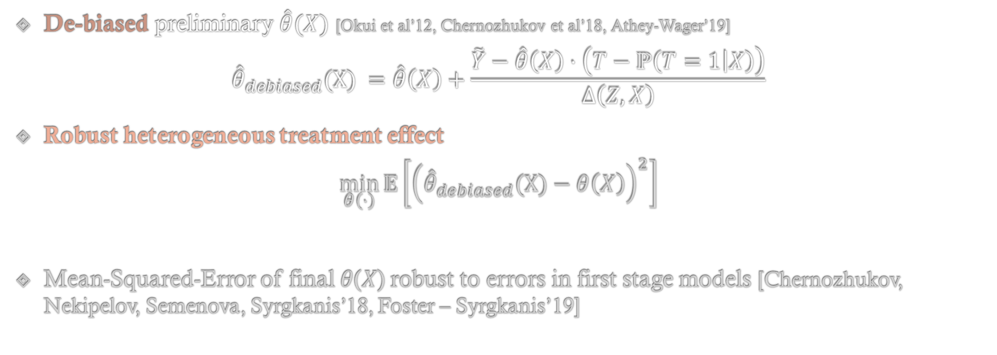
Robustness via Debiasing
Debiasing Correction: uses quantities that ideally are mean zero
De-biased preliminary $\hat{θ}(X)$ [Okui et al’12, Chernozhukov et al’18, Athey-Wager’19]
$${\hat{θ}}_{debiased}(X) =\hat{θ}\left(X\right)+\frac{\tilde{Y}−\hat{θ}\left(X\right)⋅\left(T−ℙ\left(T=1 | X\right)\right)}{Δ\left(Z,X\right)}$$
Robust heterogeneous treatment effect
$$\min_{θ\left(⋅\right)}{𝔼\left[{\left({\hat{θ}}_{debiased}(X)−θ\left(X\right)\right)}^{2}\right]}$$
Mean-Squared-Error of final 𝜃(𝑋) robust to errors in first stage models [Chernozhukov, Nekipelov, Semenova, Syrgkanis’18, Foster – Syrgkanis’19]
ML
Notes:
Again techniques from econometrics and, in particular, semi-parametric inference, can save the day
We can use the idea of debiasing, to remove the heavy dependence on the bias introduced by these first stage ML models
We are essentially adding a random correction term to our current estimate of the causal effect, which should be mean zero; had our ML estimates been unbiased; but which otherwise corrects the bias.
Then we can construct a more accurate heterogeneous effect model by solving another prediction problem where we try to predict this random “debiased” effect from the user characteristics
We can then show, mathematically, that the estimation error of this new causal model is robust to errors in the auxiliary first stage models
This builds upon a recent statistical framework that we proposed in these two works that combines ideas from semi-parametric inference in econometrics and machine learning theory.
11 - 12

Slide 29
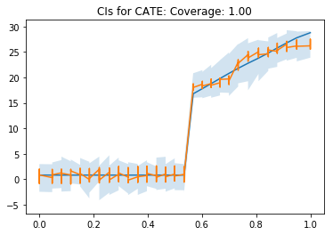
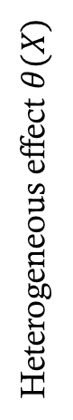
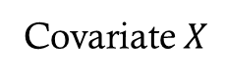
Inference
When final ML method supports CI construction, debiased final estimate typically preserves the asymptotic validity of the intervals
Inference on best linear projection of heterogeneous effect via OLS [Chernozhukov et al’16]
Inference on high-dimensional linear projections via Debiased Lasso [Zhang-Zhang’14, Javanmard-Montanari’14, van der Geer et al’14, Chernozhukov et al’17]
Non-Parametric inference via Honest Regression Forests [Athey-Wager’15, Athey-Wager-Tibshirani’16, Mentch-Hooker’16, Oprescu et al’19, Syrgkanis-Zampetakis’20]
Heterogeneous effect $θ(X)$
Covariate $X$
Notes:
Finally, in most policy problems, we don’t only care about small estimation error, but also inference; the ability to attach a confidence level to our predictions
It turns out that this debiasing idea helps in this direction too
Of course if we use an arbitrary ML method for the final estimation step, then most times we won’t be able to argue about uncertainty
However, there has been a surge of recent theoretical developments that adapt machine learning methods in manners that allow for confidence interval construction
These adaptations typically change the ML method so as to penalize bias more than variance in this balancing act, while still maintaining the data-adaptive properties of ML estimators and bypassing the curse of dimensionality
For instance, we can use variants of random forests developed by the seminal works of Athey and Wager and Mentch and Hooker, that allow for confidence interval construction;
Moreover, as we show in a recent work these variants can provably adapt to the unknown number of relevant features and provide valid non-parametric inference in high-dimensional settings
12 - 13

Slide 30
Some Caution
Only requirement from ML models should be a guarantee on expected prediction error on data from same distribution as the training data
ML methods balance bias and variance; leads to biased estimates and wrong p-values
Many times we need to solve much more complex prediction tasks than the quantity we care about; can we not depend heavily on the estimation error of these tasks
Notes:
With these modifications we have also addressed these last two points of caution.
13- 13.10

Slide 31
TripAdvisor Experiment
For random half of 4 million users, easier sign-up flow was enabled
Easier sign-up incentivizes membership
Outcome: number of visits in the next 14 days
High Level Empirical Findings
Large effect heterogeneity based on which pages were recently visited
Large effect heterogeneity based on platform of access (e.g. iPhone, Linux etc.)
Results enable better targeting of right user population and improvements of membership offering for user segments with small/almost zero effects
Notes:
Going back to our TripAdvisor problem
We applied these methods to the data from the recommendation A/B test
The high level empirical findings were that
There was large effect heterogeneity based on which pages the user had recently visited and from which platform they accessed the webpage
These results enabled better targeting of the user population and improvements of the membership offering for user segments with small effect
13.10 - 14

Slide 32
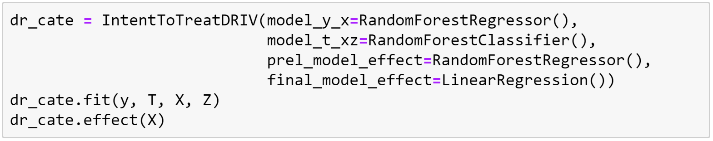
EconML in Action
EconML python library for ML Estimation of Heterogeneous Treatment Effects
https://github.com/microsoft/EconML
`pip install econml`
ALICE (Automated Learning and Intelligence for Causation and Economics) project:
https://www.microsoft.com/en-us/research/project/alice/
Notes:
We have also incorporated the method outlined into our more general-purpose open source package for the estimation of heterogeneous treatment effects using machine learning and you can easily try it out on your problem.
14.40-15

Slide 33
Deep Dive 2: Long-term effects of new treatments
Through the lens of a Return-on-Investment (ROI) Case-Study at Microsoft

Slide 34

Estimating Long-Term Returns on Investment
Companies frequently deploys new discount or customer support programs
Which of these programs (“investments”) are more successful than others?
Success is a long-term objective: what is the effect of the program on the two-year customer journey (e.g., effect on two-year revenue)
We cannot wait two years to evaluate a program
Main Question. Can we construct estimates of the values of these programs with short-term data, e.g. after 6 months?

Slide 35

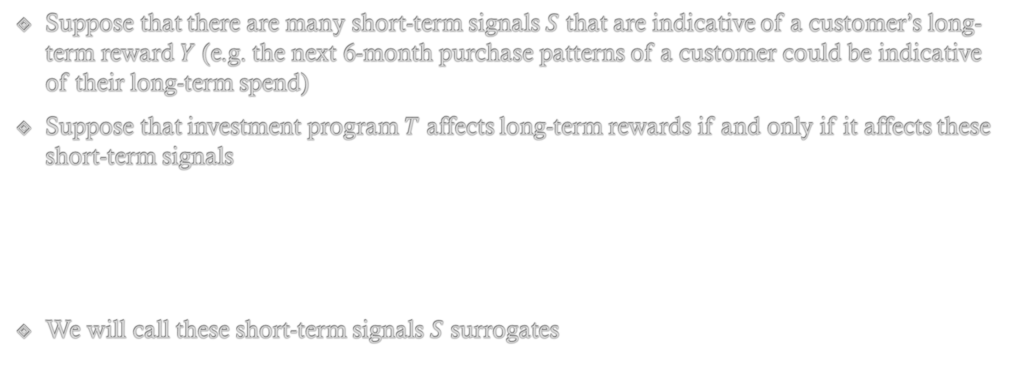


Long-Term Effects from Short-Term Surrogates
Suppose that there are many short-term signals $S$ that are indicative of a customer’s long-term reward $Y$ (e.g. the next 6-month purchase patterns of a customer could be indicative of their long-term spend)
Suppose that investment program $T$ affects long-term rewards if and only if it affects these short-term signals
We will call these short-term signals $S$ surrogates
$T$
$S$
$Y$

Slide 36


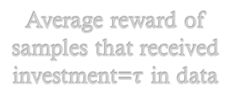
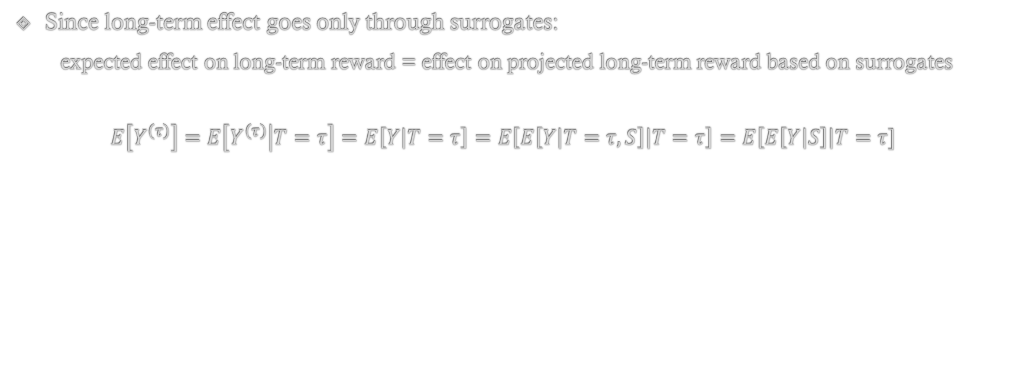
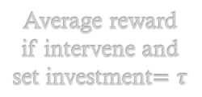





Causal Inference with Surrogates 101
(Prentice, 1989; Begg & Leung, 2000; Frangakis & Rubin, 2002; Freedman et al., 1992; Athey et al., 2020)
Since long-term effect goes only through surrogates:
expected effect on long-term reward = effect on projected long-term reward based on surrogates
$$E\left[Y^{\left(τ\right)}\right]=E\left[Y^{\left(τ\right)} | T=τ\right]=E\left[Y | T=τ\right]=E\left[E\left[Y | T=τ, S\right] | T=τ\right]=E\left[E\left[Y | S\right]\right|T=τ]$$
Average reward if intervene and set investment$=τ$
Independence in counterfactual graph
Average reward of samples that received investment=$τ$ in data
Tower Law of Expectations
Forecasted reward from surrogates
$S^{\left(τ\right)}$
$Y^{\left(τ\right)}$
$$T$$
$$τ$$
$T$
$S$
$Y$

Slide 37


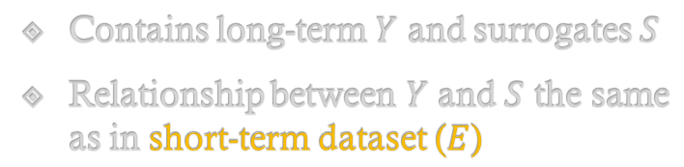


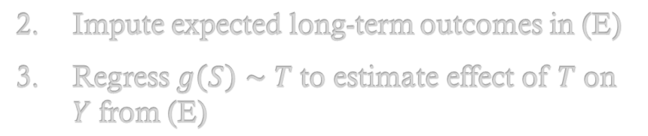

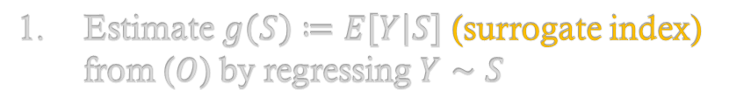

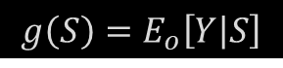
Causal Inference with Surrogates 101
historical/long-term (O)
recent/short-term (E)
Contains long-term $Y$ and surrogates $S$
Relationship between $Y$ and $S$ the same as in short-term dataset ($E$)
$$T$$
$$T$$
$$S$$
$$Y$$
$$S$$
$$Y$$
$$g\left(S\right)=E_{o}\left[Y | S\right]$$
Estimate $g\left(S\right)≔E\left[Y | S\right]$ (surrogate index) from ($O$) by regressing $Y∼S$
Impute expected long-term outcomes in (E)
Regress $g\left(S\right)∼T$ to estimate effect of $T$ on $Y$ from (E)

Slide 38

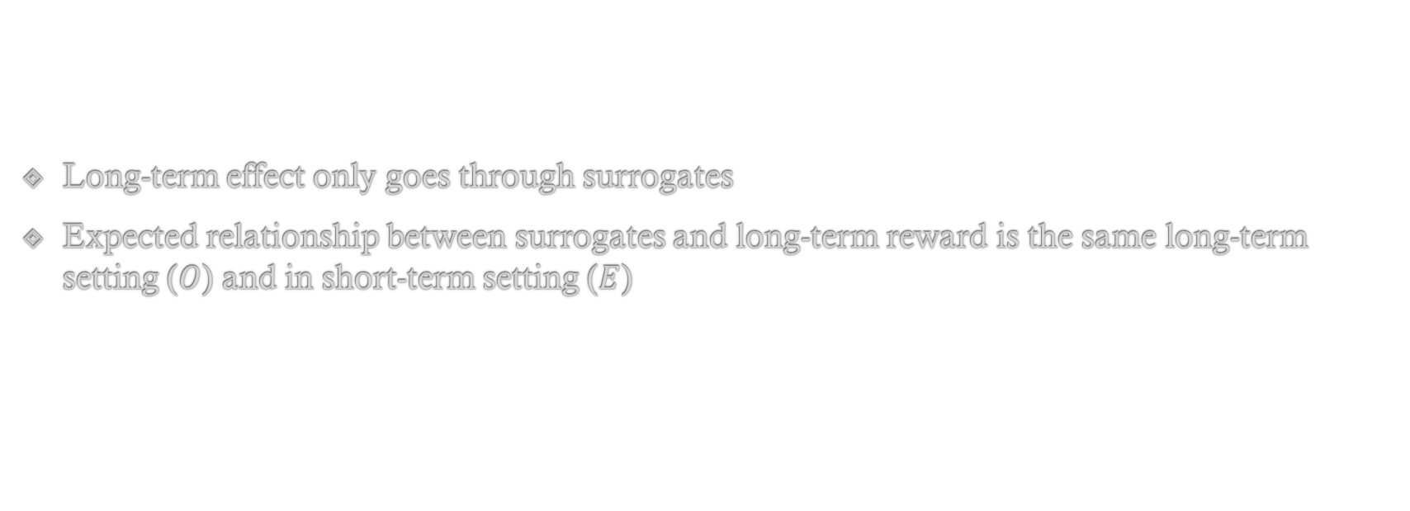
Key Assumptions
Long-term effect only goes through surrogates
Expected relationship between surrogates and long-term reward is the same long-term setting ($O$) and in short-term setting ($E$)

Slide 39
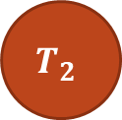




Key Assumptions can be Easily Violated Investment policies are dynamic and change
historical/long-term (O)
recent/short-term (E)
$$T_{1}$$
$$T_{2}$$
$$T_{1}^{new}$$
$$S$$
$$Y$$
$$S$$
$$Y$$
We deployed older/deprecated investments
In a potentially long-term highly auto-correlated manner
Investments are potentially adaptive
Investment policies change

Slide 40
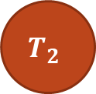









Beyond Two Periods
historical/long-term (O)
recent/short-term (E)
$$T_{1}$$
$$T_{2}$$
$$T_{3}$$
$$T_{1}^{new}$$
$$S_{1}$$
$$S_{2}$$
$$Y$$
$$S_{0}$$
$$S_{1}$$
$$Y$$
Treatments are offered in an adaptive manner, in response to previous period surrogate/state
The surrogate – treatment feedback precludes viewing this as a one-shot treatment problem
Setting is known as the dynamic treatment regime [Robins’94,’04, Chakraborty-Murphy’14]

Slide 41



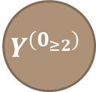






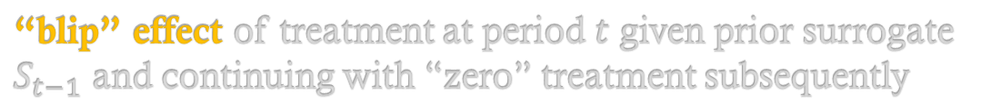
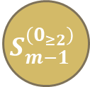

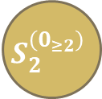

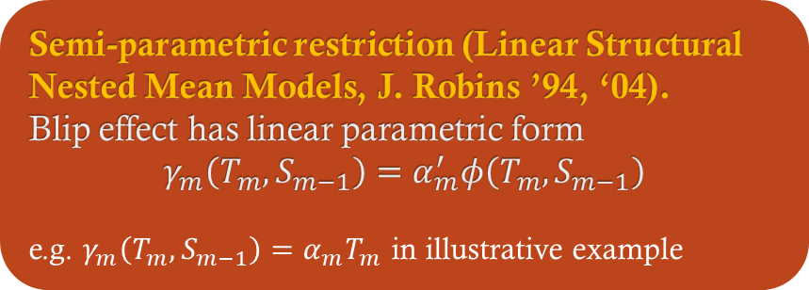
General Setting
historical/long-term (O)
recent/short-term (E)
$$T_{1}$$
$$…$$
$$T_{1}^{new}$$
$$T_{2}$$
$$0$$
$$T_{3}$$
$$0$$
$$T_{m}$$
$$0$$
$$…$$
$$S_{1}$$
$$S_{2}^{\left(0_{≥2}\right)}$$
$$…$$
$$S_{m−1}^{\left(0_{≥2}\right)}$$
$$Y^{\left(0_{≥2}\right)}$$
$$S_{0}$$
$$S_{1}$$
$$Y$$
$$g^{adj}\left(S_{1}\right)=E_{o}\left[Y^{\left(0_{≥2}\right)} | S_{1}\right]$$
Semi-parametric restriction (Linear Structural Nested Mean Models, J. Robins ’94, ‘04).
Blip effect has linear parametric form
$$γ_{m}\left(T_{m},S_{m−1}\right)=α_{m}^{′}φ\left(T_{m},S_{m−1}\right)$$
e.g. $γ_{m}\left(T_{m},S_{m−1}\right)=α_{m}T_{m}$ in illustrative example
$$=E_{o}\left[\left.Y−\sum_{t≥2}{γ_{t}\left(T_{t},S_{t−1}\right)}\right|S_{1}\right]$$
“blip” effect of treatment at period $t$ given prior surrogate $S_{t−1}$ and continuing with “zero” treatment subsequently

Slide 42
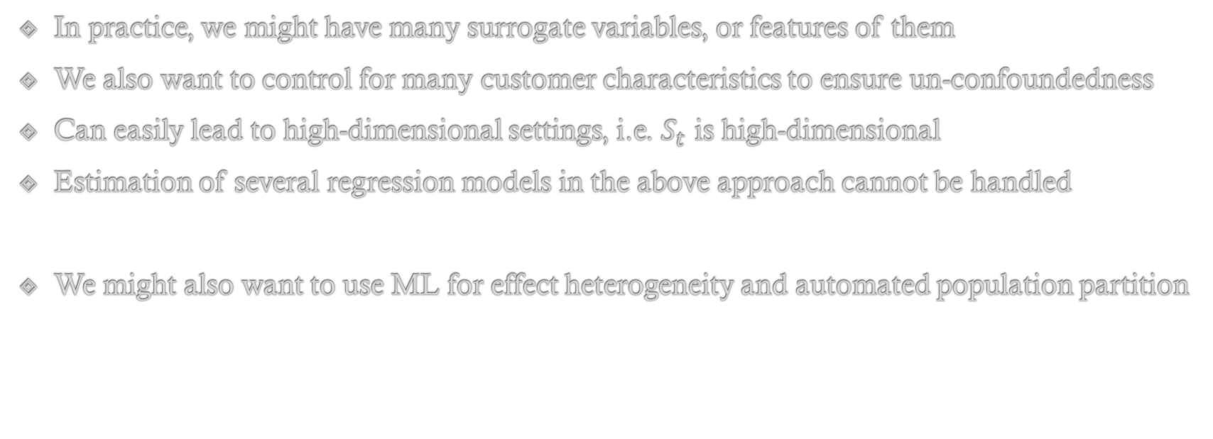
Machine Learning Estimation
In practice, we might have many surrogate variables, or features of them
We also want to control for many customer characteristics to ensure un-confoundedness
Can easily lead to high-dimensional settings, i.e. $S_{t}$ is high-dimensional
Estimation of several regression models in the above approach cannot be handled
We might also want to use ML for effect heterogeneity and automated population partition

Slide 43
Machine Learning and Bias
Can we simply replace linear regression with high-dimensional linear regression analogues in these models (e.g. lasso)
Can lead to biased effect estimates and non-asymptotically normal estimates
Inability to construct confidence intervals for our estimates
Developed a novel debiased machine learning inference procedure for this setting

Slide 44
EconML in Action

Slide 45
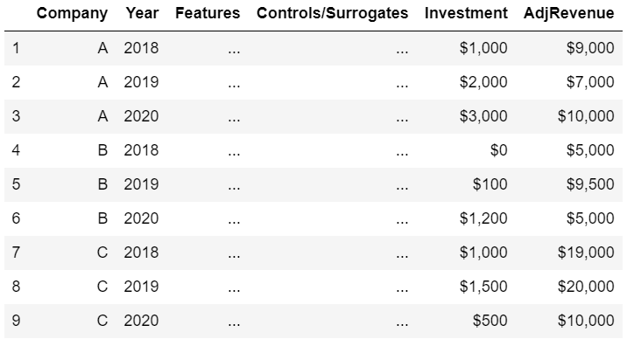
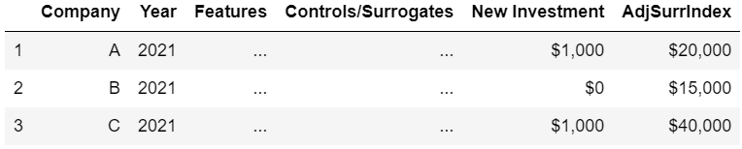
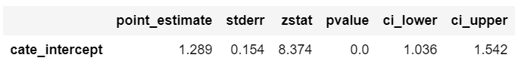
EconML: Adjusted Surrogate Index
Historical Long-Term Data
from econml.dml import DynamicDML, LinearDML
est = DynamicDML(model_y=LassoCV(), # Any ML model for E[Y_t | S_{tau}]
model_t=LassoCV()) # Any ML model for E[T_t | S_{tau}]
# on historical data construct adjusted outcomes
for t in np.arange(1, period): # for each target period 1...m
est.fit(long(y[:, 1:t]), long(T[:, 1:t]), W=long(W[:, 1:t]), groups=groups)
yadj[:, t] = y[:, t] - est.effect(T0=0, T1=wide(T[:, 1:t]))
# fit surrogate model using W[:, 1] as surrogates
adj_surr_model = LassoCV().fit(W[:, 1], np.sum(yadj, axis=1))
Short-Term Data with New Investment
# on recent data impute surrogate index
adj_surr_index = adj_surr_model.predict(Wnew[:, 1])
# estimate causal effect on adj_surr_index controlling for Wnew[:, 0]
new_est = LinearDML(model_y=LassoCV(), model_t=LassoCV())
new_est.fit(adj_surr_index, Tnew, W=Wnew[:, 0]).summary()

Slide 46
Practical Challenges
Unobserved confounding
Outlier robustness
Asymptotic nature of many inference procedures
Interpretability of assumptions and conclusions
Measures of “success”
Scalability to ultra large data-sets (many features or many samples)

Slide 47
Deep Dive 3: Further tools for reducing barriers to entry

Slide 48
Making CausalML Accessible to Every Decision-Maker
Need to make it as accessible as modern AutoML systems
Causal inference is inherently harder than prediction
Data Collection
Estimation
(training)
Validation
(testing)
Predictive modelling

Slide 49
Making CausalML Accessible to Every Decision-Maker
Need to make it as accessible as modern AutoML systems
Causal inference is inherently harder than prediction
Data Collection
Estimation
(training)
Validation
(testing)
Interpretation
Predictive modelling

Slide 50
Making CausalML Accessible to Every Decision-Maker
Need to make it as accessible as modern AutoML systems
Causal inference is inherently harder than prediction
Data Collection
Estimation
(training)
Validation
(testing)
InterpretationPolicy Recommendations
Domain Assumption Elicitation
Identification Strategy
Causal modelling

Slide 51
Making CausalML Accessible to Every Decision-Maker
Need to make it as accessible as modern AutoML systems
Causal inference is inherently harder than prediction
Data Collection
Estimation
(training)
Validation
(testing)
Interpretation Policy Recommendations
Domain Assumption Elicitation
Identification Strategy
Sensitivity analysis
Causal modelling

Slide 52
Making CausalML Accessible to Every Decision-Maker
Need to make it as accessible as modern AutoML systems
Causal inference is inherently harder than prediction
Data Collection
Estimation
Inference
Validation
InterpretationPolicy Recommendations
Domain Assumption Elicitation
Identification Strategy
Sensitivity analysis
Causal modelling

Slide 53
The Causal Inference Pipeline
Data Collection
Identification Strategy
Estimation/Inference
Sensitivity Analysis
Active data collection
Domain Assumption Elicitation
Interpretation/Policy Recommendations
Validation

Slide 54
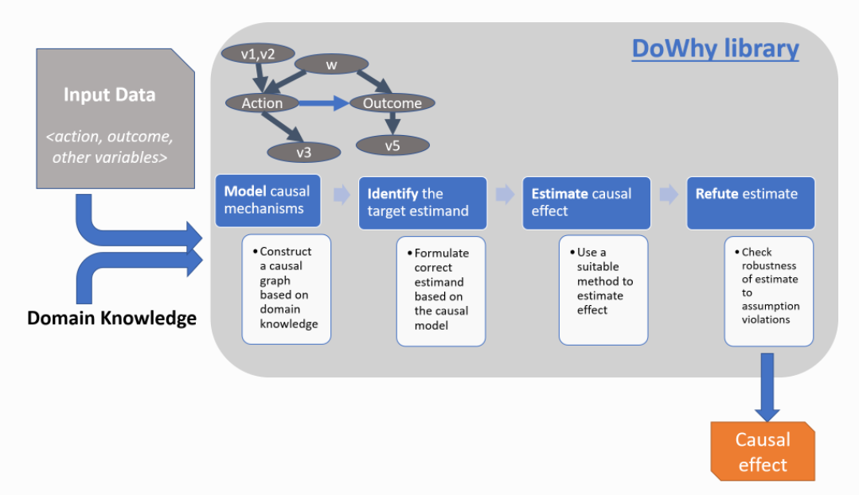
DoWhy Python Package Guiding the Data Scientists through the Causal Pipeline
[2108.13518] DoWhy: Addressing Challenges in Expressing and Validating Causal Assumptions (arxiv.org)

Slide 55
Towards No-Code Interfaces

Slide 56
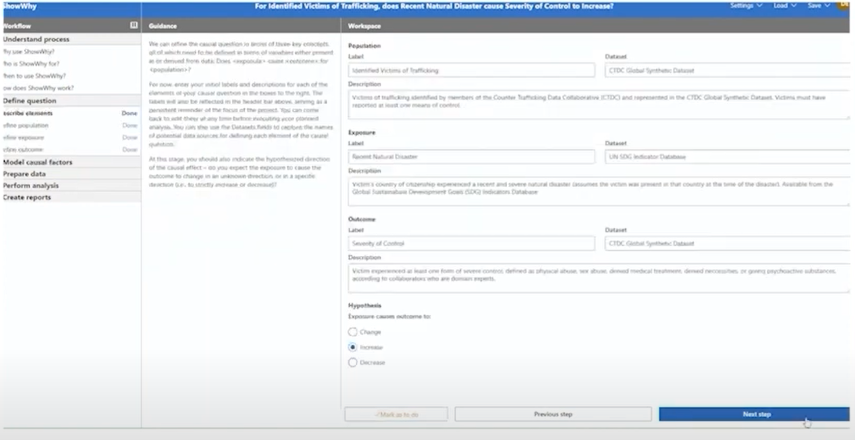
ShowWhy

Slide 57
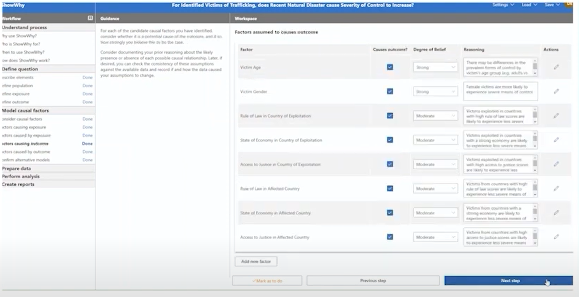
ShowWhy

Slide 58
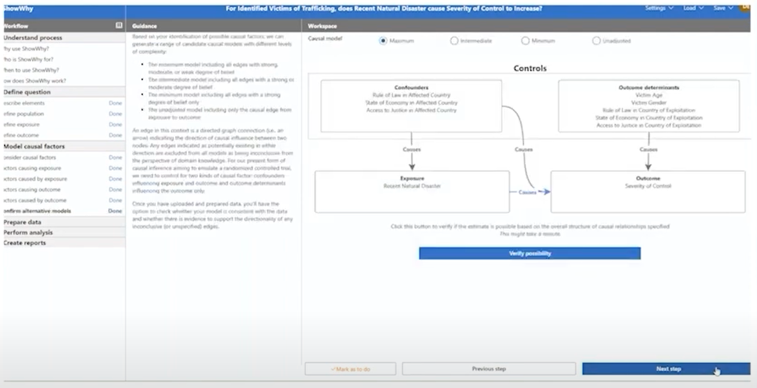
ShowWhy

Slide 59
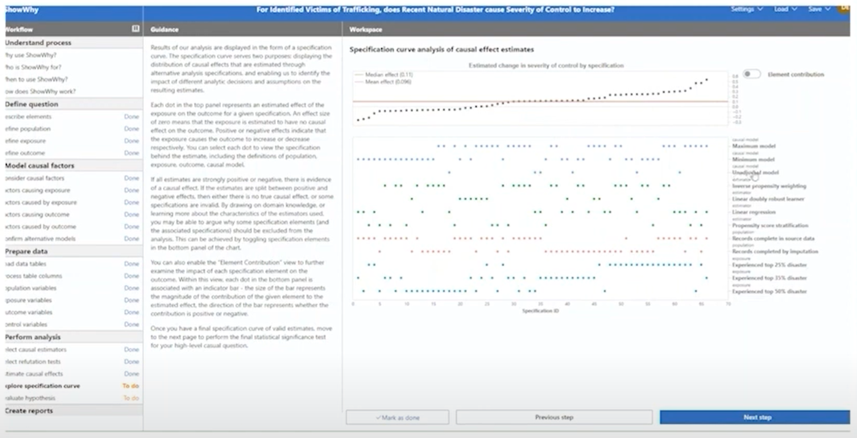
ShowWhy
microsoft/showwhy (github.com)

Slide 60
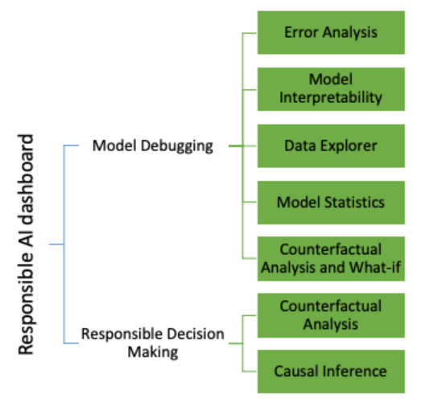
AzureML Responsible AI Dashboard

Slide 61
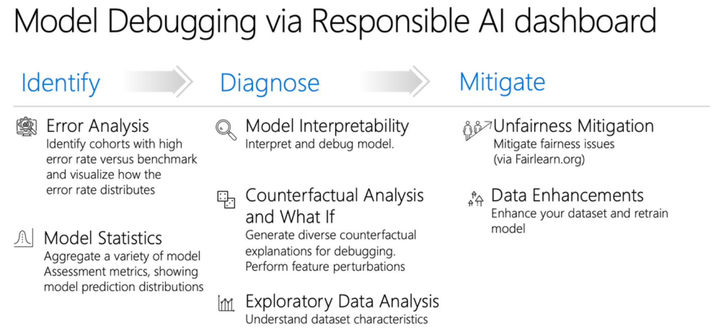
AzureML Responsible AI Dashboard

Slide 62

AzureML Responsible AI Dashboard

Slide 63


Slide 64


Slide 65


Slide 66
The Causal Inference Pipeline
Data Collection
Identification Strategy
Estimation/Inference
Sensitivity Analysis
Active data collection
Domain Assumption Elicitation
Interpretation/Policy Recommendations
Validation

Slide 67
Many Research Challenges
Robustness to data corruption/adversarial attacks
Data Collection
[NeurIPS’17, NeurIPS’21 MLEcon workshop]
Identification Strategy
[NeurIPS’21a,b]
Estimation/Inference
[COLT’19\R&R AoS, COLT’20, NeurIPS’20, NeurIPS’21]
Sensitivity Analysis
[Arxiv’21]
Active data collection
[EC’15/OR’20, EC’26/OR21, ICML’16, NeurIPS’16, FOCS’17, ICML’18a,b, ICML’21]
Domain Assumption Elicitation
[Clear’22]
Interpretation/Policy Recommendations
[NeurIPS’19, ICLR’21,CLear’22]
Validation
[COLT’19]
Long-term outcomes
Safety constraints
Fairness and ethical constraints
Experimentation constraints (ability to intervene on subsets of variables)
Interactive assumption elicitation (query complexity)
Causal Representation Learning for unstructured data
Incorporate non-graphical restrictions in automated graph-based identification algorithms
Computationally efficient sensitivity analysis
Automated de-biasing in general (e.g. dynamic regime, mediation effects)
Unobserved confounding
Post adaptive data collection inference
Post causal discovery inference
Evidence based interpretations for policy makers
Causal attribution
Good losses for causal model selection
[2108.13518] DoWhy: Addressing Challenges in Expressing and Validating Causal Assumptions (arxiv.org)

Slide 68
Causal Identification
Potential Outcomes Structural Equations Directed Acyclic Graphs (DAGs)
Graphical Criteria Single World Intervention Graphs
Unobserved Confounding: Instruments, Diff-in-Diff, Regression Discontinuity
Double/Debiased Machine Learning (DML)
Automatic DML for Static and Dynamic Treatments (Reinforcement Learning)
Automatic DML for Proximal Inference and Instrumental Variables
Statistical learning theory for heterogeneous treatment effects
Non-parametric inference for heterogeneous treatment effects (Causal Forests)
Statistical learning theory for conditional moment problems (instrumental variables)
Estimation and Inference on Causal Parameters
Estimation and Inference on Causal Functions

Slide 69

Thank you!

